Slide 1
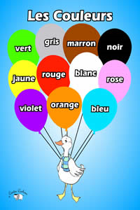
Mon Personnage Porte (my character is wearing)
Draw your own character(s)
Use 10 items from the vocabulary sheet
When done drawing, write a sentence for each clothing piece
“mon personnage porte les lunettes rouge”
Mon personnage porte + item + colour = sentence

